Slide 1
Test Cases
Revision 17 - Correction

Slide 2

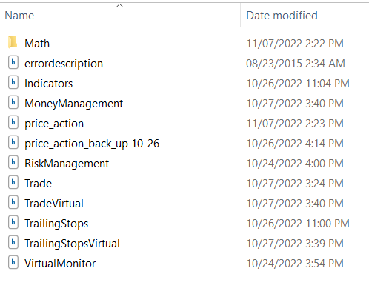
Details
Program Name:
Orb_reset_32_initial_oop_code_with_trading_hours_correction.mq5
Include Files

Slide 3
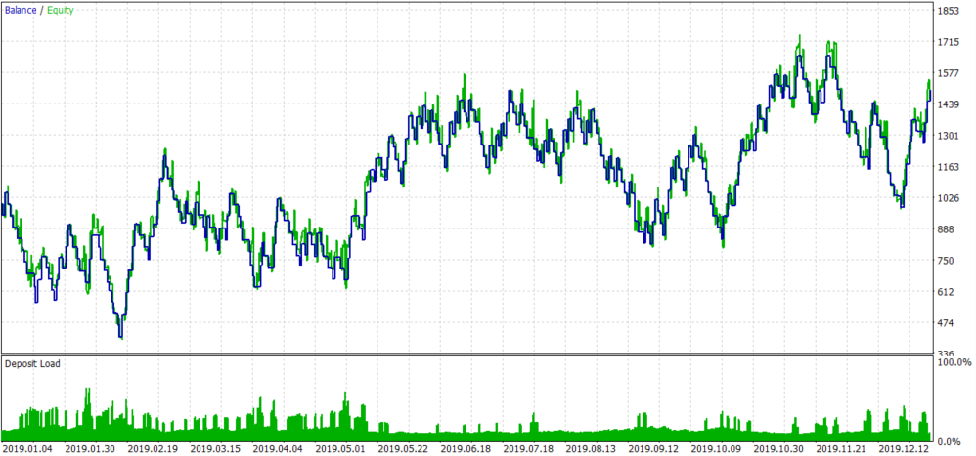
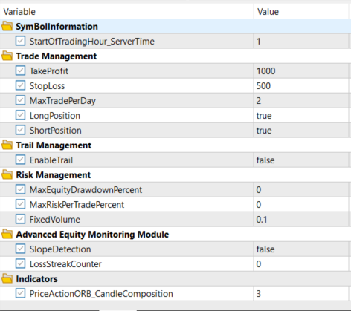

2019 RRR2 (500-1000)

Slide 4
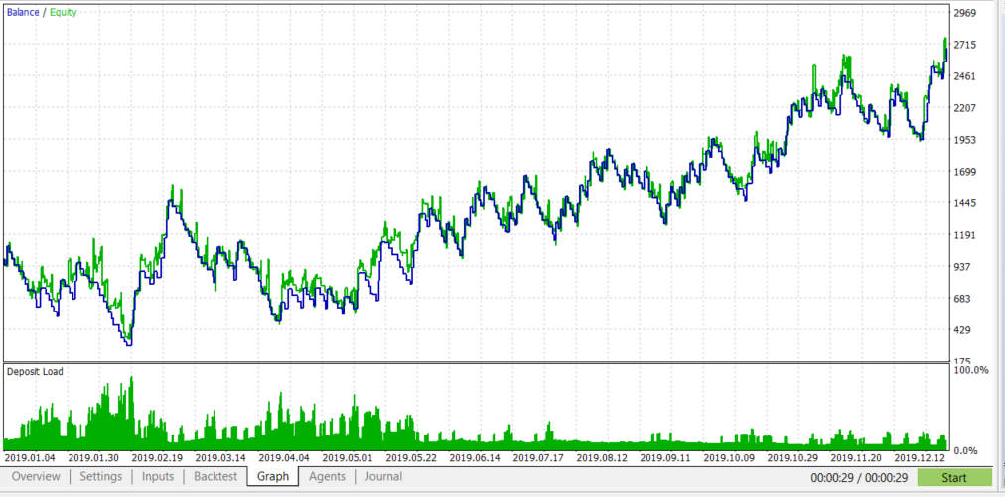
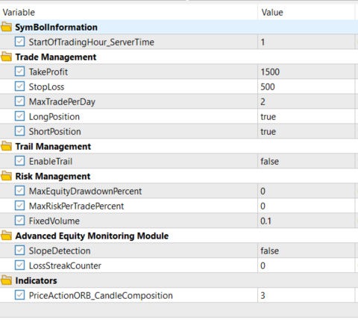

2019 RRR3 (500-1500)

Slide 5
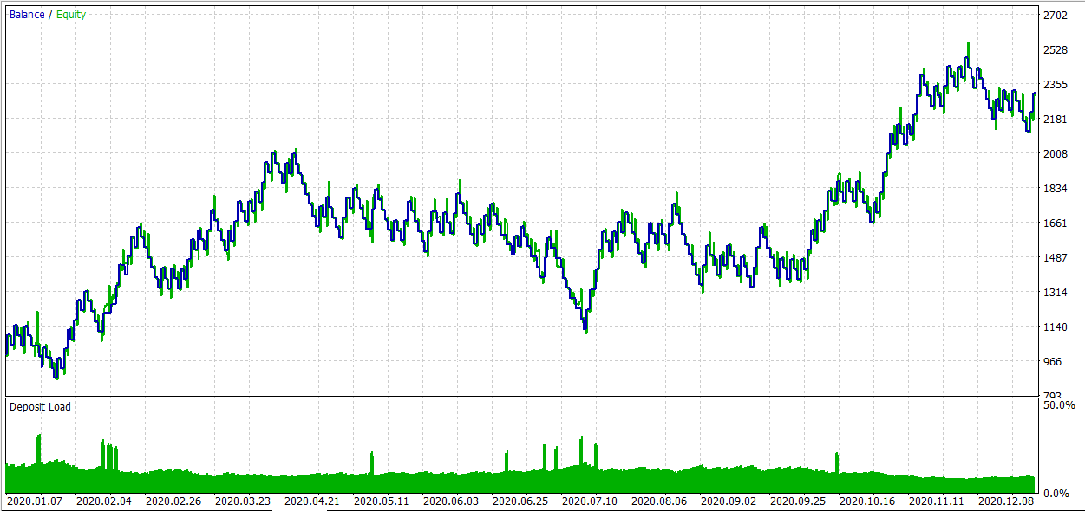
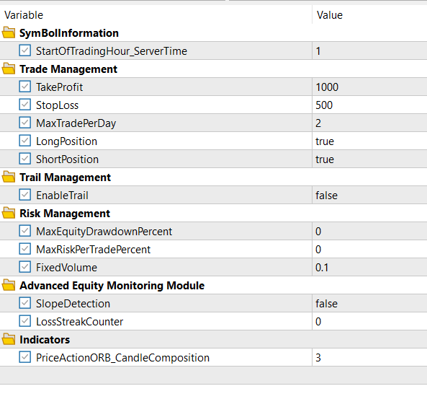

2020 RRR2 (500-1000)

Slide 6
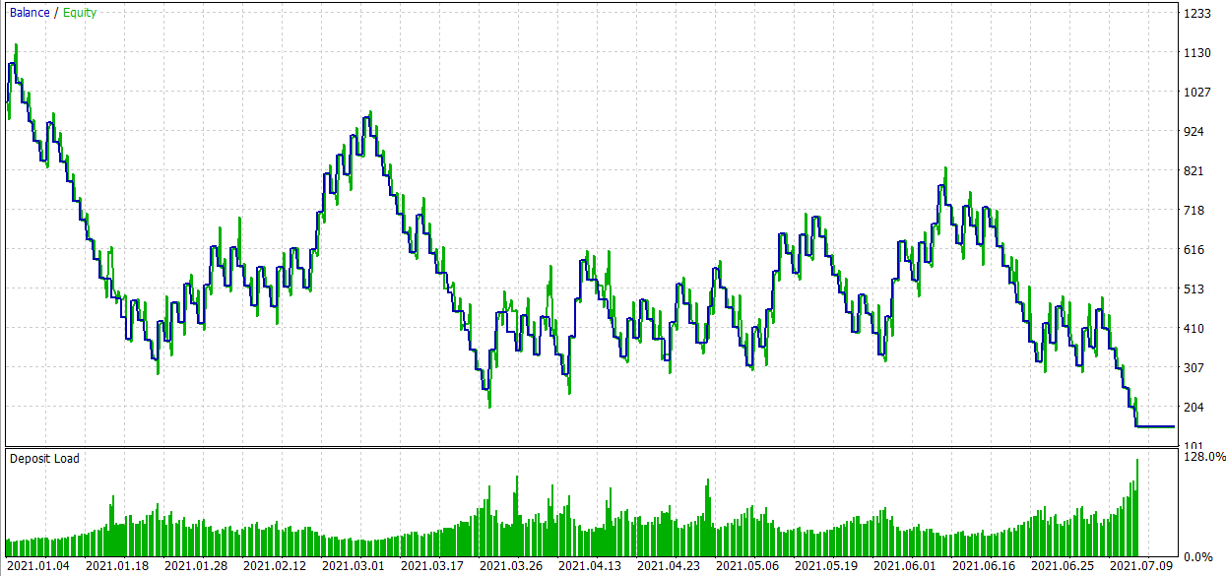

2021 RRR2 (500-1000)

Slide 7
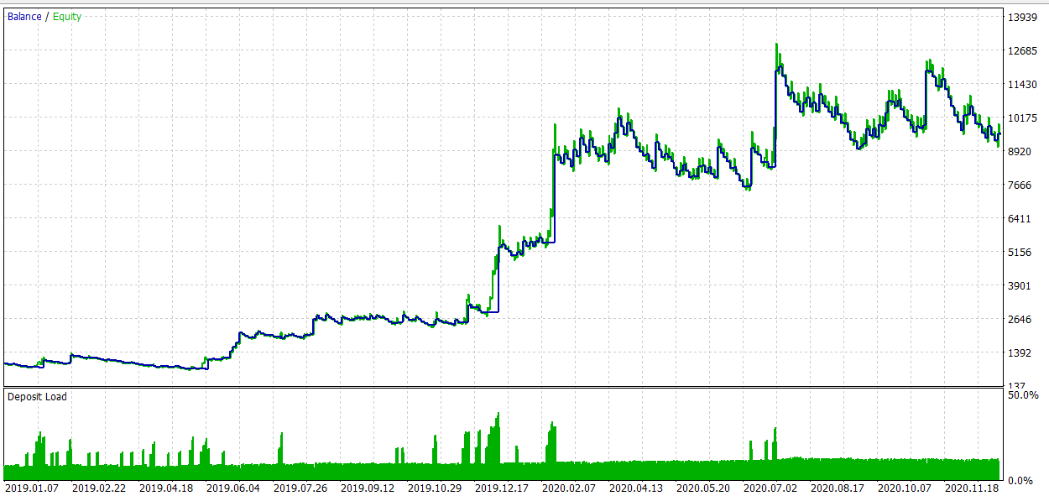
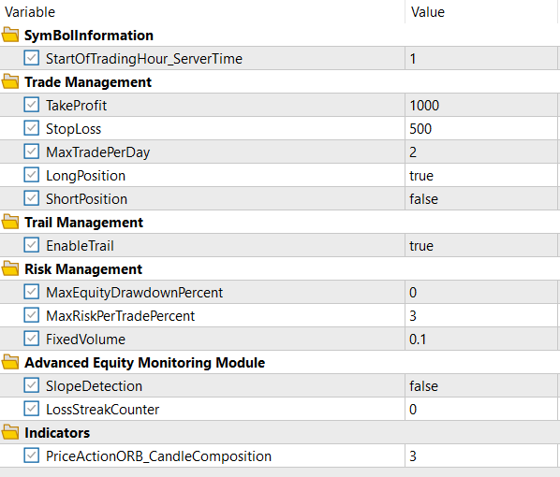

2019-2021 RRR2 (500-1000)- 3% risk/Trade

Slide 8
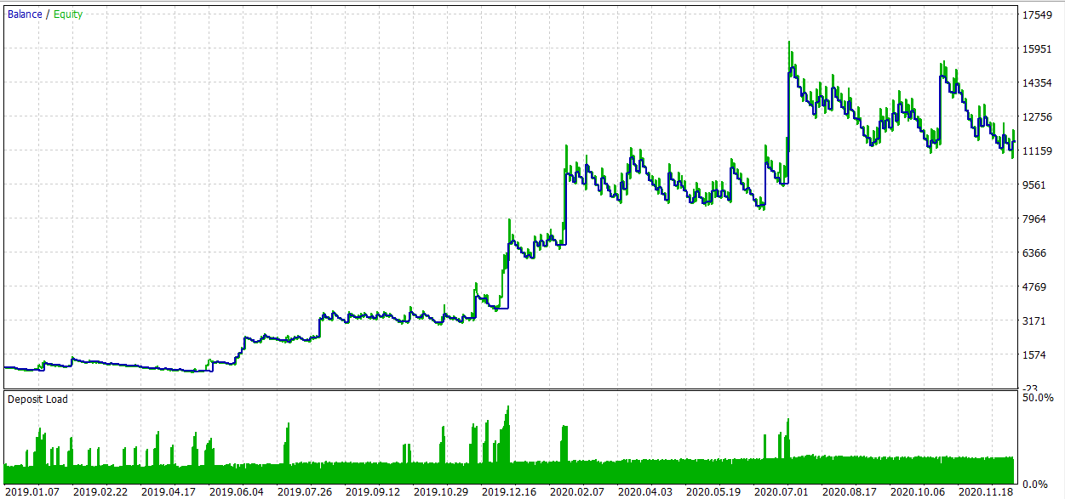


2019-2021 RRR2 (400-1200)- 3% risk/Trade –Long only

Slide 9
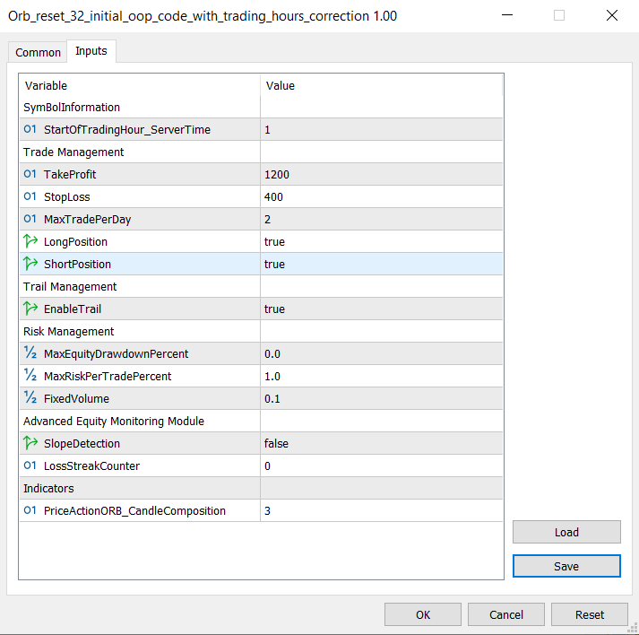



Default Input

